Slide 1
Accident Severity Model
Ray Julin
Coursera Capstone

Slide 2
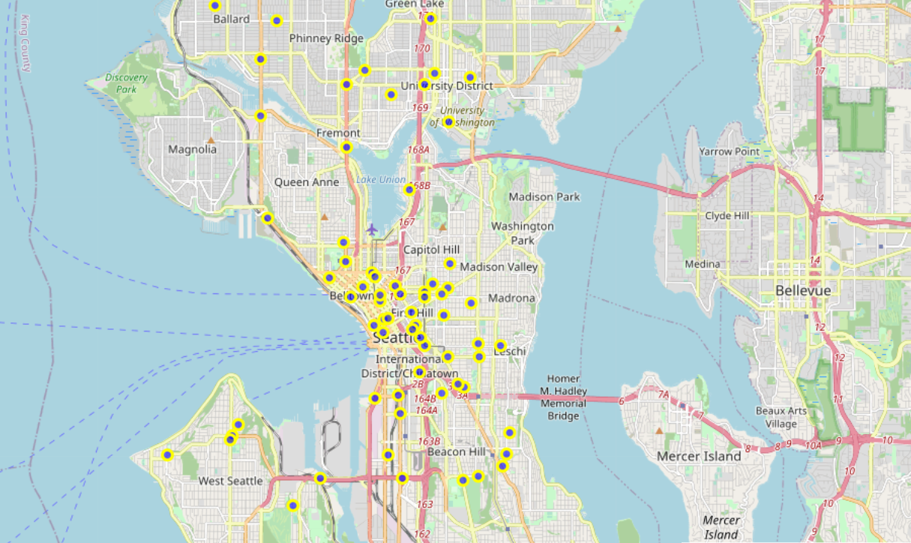
The data set used is from the SDOT Traffic Management Division for Collisions—All Years. from the Traffic Records Group. SDOT GIS Analyst.

Slide 3
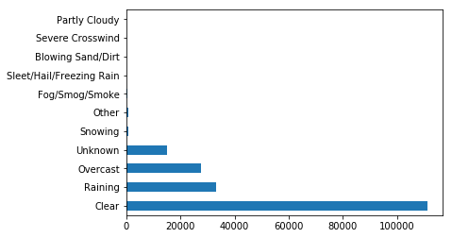
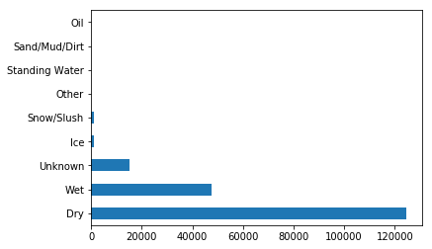
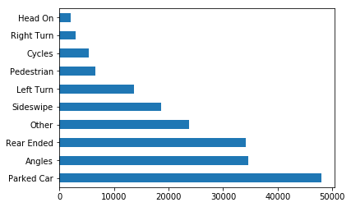
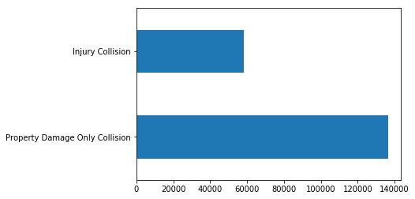
Data Review

Slide 4
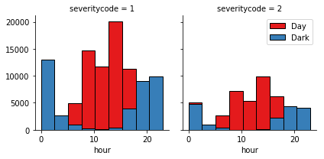
Severity Code 1: Property Damage = Most Common Accident
Severity Code 2: Injury Accident

Slide 5
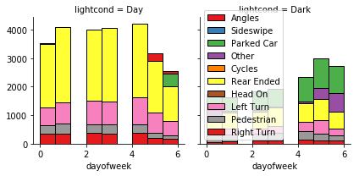
Accidents involving parked cars most often occur at night
Left turn accidents are more common during the day
The most common day time accident is Getting rear ended

Slide 6
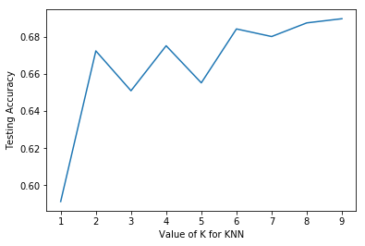
KNN Model

Slide 7
Conclusions
We can see here that if an accident occurs at night it is more likely to be on a weekend Friday, Saturday or Sunday, it is least likely to be on a Monday
Fridays have a high occurrence of daytime and nighttime accidents but Sunday is the least dangerous day for daytime accidents which makes sense since most people stay home on Sundays and go out on weekends
The model does a reasonably good job of predicting injuries or property damage only accidents. Unfortunately the data does not include further classification of fatalities or types of injuries incurred and by who. With this data we could better prepare first responders to react to accidents give a time of day, day of week, weather, and road conditions.

